Slide 1
Welcome to 3rd Grade Curriculum Night
2019- 2020

Slide 2
Agenda
Communication
Class Procedures
Curriculum
Assessment
Behavior Expectations
Food
Parent Involvement
Log In Information
Questions

Slide 3
Communication
E-mail: nicole.shuler@lok12.org
Homework log
Phone: 248-693-5460 ext. 2310
Visit the class website weekly to find out news: http://mrsnicoleshuler.weebly.com/

Slide 4
Class Procedures
ClassWork
HomeWork
Expectation all work will be done in class.
Students keep work in folders.
Sometimes individual or group work given.
Standards-based grading is used: 4, 3, 2, 1.
Log signed and turned in daily. Reading every night. (20 min.) Students are welcome to check out books.
Math Homework: given periodically based on unit.
Sometimes Writing, S.S., and Science when not finished in class.
All work will be turned in by due date.

Slide 5
Language Arts Curriculum
Reading Workshop approach
Students read at their independent level and are taught how to choose books.
Teacher confers with students to meet needs.
Writing Workshop approach (Lucy Calkins)
Narrative, Informational, Opinion, and Research writing.
Word Study: Words their Way with a focus on study of words and their patterns
Students are grouped into developmental levels based on word study inventories. Not all students will have the same words.
Students are introduced to a new group of words with a specific feature as its focus weekly or bi-weekly.
Students sort words, complete word hunts, play games, and keep a word study notebook.
Students assessed using various measures not just spelling tests.

Slide 6
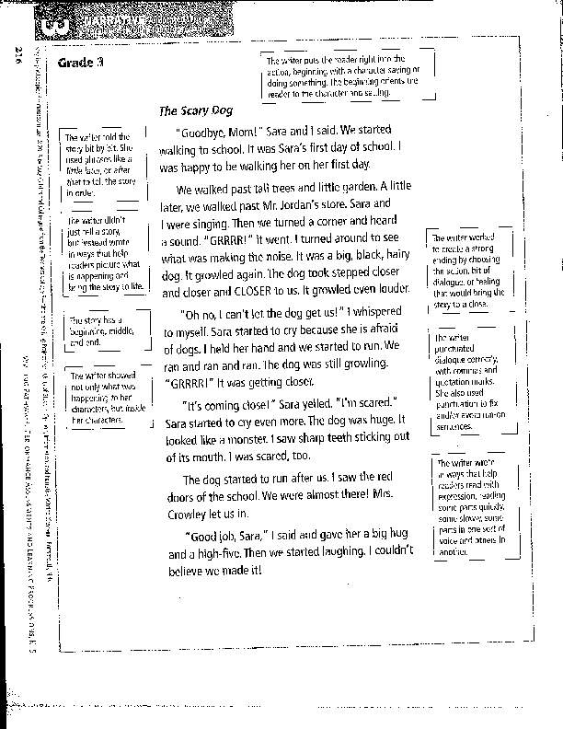
Writing Expectation
3rd Grade Narrative

Slide 7
Science and Social Studies
Science:
Weather (Wild, Wacky Weather)
Forces and Interactions (Let’s Move)
Environmental Impacts on Organisms (Stick Together)
S.S.: Meet MI:
Focus on development of our state, history, government, economy, geography, people who have impacted MI.

Slide 8
Math (Houghton Mifflin Expressions)
Elements of instruction that are embedded in each lesson of Math Expressions include:
Building Concepts strengthens mathematical ideas and understanding through objects, drawings, conceptual language, and real-world situations
Math Talk encourages students to share their methods orally and through proof drawings
Quick Practice allows for whole-class responses or individual partner practice
Every lesson includes intervention, on-level, and challenge differentiation to support students’ needs

Slide 9
Math
Units 1 & 2 Multiplication and Division strategies ›Unit 3 Multi-digit addition and subtraction ›Unit 4 Fractions, Time, Data ›Unit 5 Measurement and Fractions ›Unit 6 Word Problems ›Unit 7 Measurement and Polygons

Slide 10
Keyboarding/Computers
Students will participate in a keyboarding program 2 days a week this year. We will be practicing for 30 minutes each session.
Students will also have computer time to learn other programs, practice on-line test taking, and to help them complete some research projects.

Slide 11
Assessment
Test Preparation
Material taught in class
Review sent home before test
Review given in class
Test given
Retakes allowed two days after test is returned. Notify teacher.
Reading: anecdotal notes, observation, comprehension work, and TC and fluency work
Math: unit testing, with some daily work and end of quarter common assessments
Sci/S.S.: end of unit tests, projects, classwork
Word Study: word sorts, tests, activities
M-STEP: in spring- online standardized test

Slide 12
School-Wide Behavior Plan
We have spent time discussing our rules and the children know that they are responsible for their actions. I will encourage them to make good choices every day and help others as well.
What is the heart of it?
Students knowing specifically what to do
Students self-monitoring themselves to be sure they are doing it
Classroom teachers at the forefront of the behavior intervention system
What does it include?
Behavior lessons
Class meeting structure
Kind Reminder process for problem solving
The 4 Steps process when learning is interrupted
A system to reteach behaviors to students who need it

Slide 13
3rd Grade Behavior System
We have included a class economy into the behavior plan. Students who are self-monitoring will earn money. They can then use that money to buy things in class. Once a marking period, we will have an Economics Fair. Students can make products to sell. They can also shop and buy from others. They do not need to make anything for these days. It is up to you and them!

Slide 14
Food
Allergy Aware School
Breakfast is an option before school.
Lunch: 11:00- 11:48 (recess at 11:00, lunch around 11:25)
Cost: $2.90 (Can pay by cash or on-line, no checks)
Snack: daily, nutritious please
Birthday Treats: not necessary but must be sent in individually wrapped with ingredients listed
Reminder- No peanuts or nut products in classrooms, but for lunch is fine.

Slide 15
Health
If your child is sick, please contact the front office and myself to let us know he/she will not be in school.
Your child needs to be fever free (without the aid of medication) for 24 hours before returning to school.
Children need to be vomit free for 24 hours before returning to school.
All medications (including cough drops) require medication forms in the office.
Please help us keep everyone healthy. If you feel your child would not be there best at school due to an illness, keep him/her home for the day.

Slide 16
Attendance
It is important for your child to be at school, on time, every day. If your child has a fever or has been vomiting, please keep him home. Otherwise, it is best that they are here.
If you need to take your child out of class early, it will reduce your wait time in the office if you notify me ahead of time. Also, please notify the office, in case there is a guest teacher.

Slide 17
Ways to help your child
Check log and green folder daily.
Help pack backpack and snack.
Utilize Blanche Sims Media page for resources such as Think Central.
Be a Mystery Reader!
Come to celebrations and Blanche Sims events. You are always welcome!
Do not hesitate to contact me. Together we can and will have a successful year.

Slide 18
Parent Involvement
Volunteers: please make arrangements with me. Some prefer working with kids and others prefer “paper”work.
Daily at home: nightly reading and homework, signing log, reading newsletter, checking power grade, etc.
P.T.O.: a fantastic organization that supports our school.

Slide 19
LO Bond Projects
Visit the link for information about the bond projects: https://www.lakeorionschools.org/bond

Slide 20
Questions?

